Slide 1

Application Development On Academix Batch Number : 05 By
Aditya Kumar Jha - 2211IT010003
Abhilash - 2211IT010022
Sai Kiran - 2211IT010027
Hruday Teja - 2211IT010041
Under the Esteemed Guidance of -
Assistant Professor
Mrs.T. Lavanya

Slide 2

Project Title
Presentation:-
Smart Academic Networking – AcademiX
An AI-driven platform that connects university students for academic support, collaboration, and mentorship.

Slide 3
Introduction:
ACT:
Smart Academic Networking – AcademiX is an AI-driven platform that connects university students for academic support, collaboration, and mentorship.
Intelligent Matchmaking – Uses machine learning to recommend peers based on skills, interests, and project requirements.
Bridging Academic Gaps – Facilitates connections between juniors and seniors, fostering knowledge sharing and mentorship.
Collaborative Learning Environment – Encourages study groups, project teams, and interactive problem-solving.
Real-World Readiness – Prepares students for teamwork, communication, and skill development beyond academics.

Slide 4
Objectives of the Project:
Enhance Peer Collaboration – Connect students based on academic needs, interests, and expertise.
Foster Mentorship – Enable structured knowledge transfer between experienced seniors and juniors.
Facilitate Group Learning – Provide a space for students to form study groups and collaborative projects.
Utilize AI for Matchmaking – Leverage machine learning to recommend ideal academic partners.
Encourage a Growth-Oriented Culture – Promote teamwork, critical thinking, and problem-solving within the university.

Slide 5
Expected Outcome:
User-Friendly Experience – A well-structured home page and personalized dashboard for seamless navigation.
Effective Matchmaking – AI-powered recommendations ensuring productive academic partnerships.
Improved Learning Outcomes – Enhanced peer engagement leading to better academic performance.
Stronger University Network – A connected academic community fostering collaboration across different levels.
Industry-Ready Skills – Structured networking that prepares students for professional teamwork and real-world problem-solving.

Slide 6
Literature Survey:
Limitations of Existing Platforms – Current systems focus on resource sharing or forums but lack intelligent matchmaking.
Inefficient Traditional Methods – Notice boards and social media groups fail to connect students with the right collaborators.
Limitations of LMS – Learning Management Systems provide discussion features but do not support skill-based networking.
AI-Driven Innovation – Machine learning has improved engagement in educational platforms through personalized recommendations.
AcademiX as a Solution – Bridges the gap by integrating AI-powered matchmaking, mentorship, and collaborative learning.

Slide 7
Methodology:
User Data Collection & Profile Setup – Students enter their academic interests, skills, and project needs, enabling AI to gather and process data for personalized matchmaking.
Machine Learning-Based Matchmaking – AI algorithms analyze student profiles to recommend connections based on shared academic goals, expertise, and collaboration potential.
Interactive Collaboration Features – In-app messaging, discussion forums, and virtual study rooms facilitate seamless communication and project collaboration.
Feedback & Adaptive Learning System – Users provide feedback on their matches, helping the AI refine recommendations and improve matchmaking accuracy over time.
Scalability & Continuous Improvement – Regular updates and potential integration with university systems and Learning Management Systems (LMS) for broader adoption and enhanced user experience.

Slide 8
Plan of Work:
Short-Term Goals:
Finalize UI/UX enhancements.
Train and refine the matchmaking AI model.
Conduct internal testing.
Long-Term Goals:
Deploy AcademiX for pilot testing in universities.
Gather user feedback for future improvements.
Expand features to include faculty-student collaborations.

Slide 9
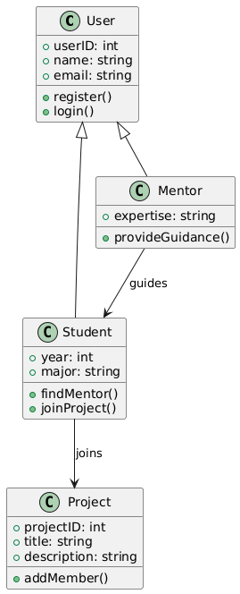
Diagrams:
Class Diagram

Slide 10
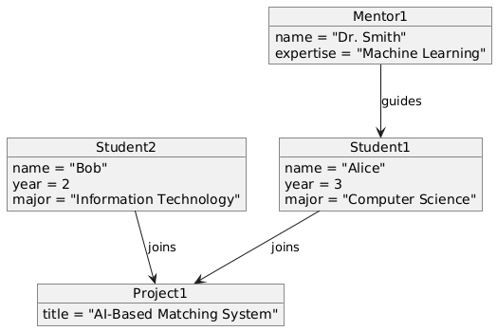
Diagrams:
Object Diagram

Slide 11
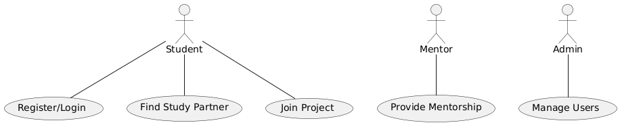
Diagrams:
Use Case Diagram

Slide 12
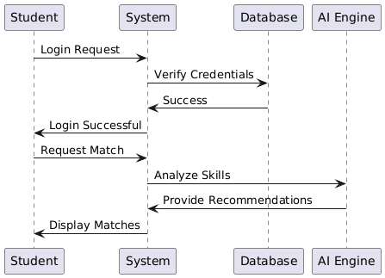
Diagrams:
Sequence Diagram

Slide 13
Diagrams:
Collaboration Diagram

Slide 14
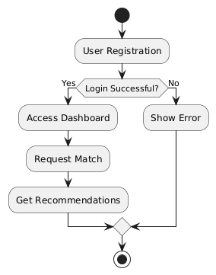
Diagrams:
Activity Diagram

Slide 15
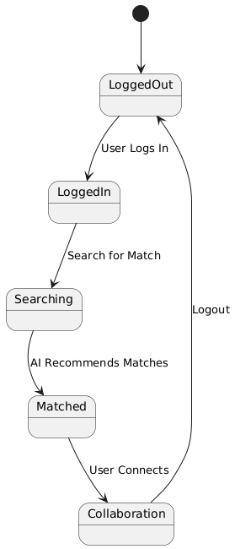
Diagrams:
Statechart Diagram

Slide 16
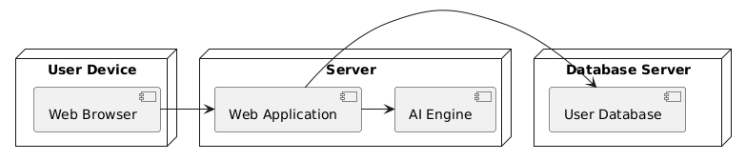
Diagrams:
Deployment Diagram

Slide 17
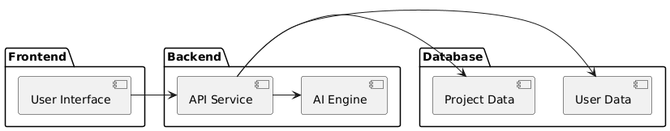
Diagrams:
Component Diagram

Slide 18
Progress of Work:
Phase 1: Research and Requirement Analysis (Completed)
Phase 2: UI/UX Design and Frontend Development (Completed)
Phase 3: Backend and AI Integration (Ongoing)
Phase 4: Testing and Optimization (Upcoming)
Phase 5: Deployment and User Testing (Planned)

Slide 19
THANK YOU

